Slide 1

SINCE 2025
Social Media Marketing
ELEVATING YOUR BRAND THROUGH PURPOSE-DRIVEN CONTENT
Zoe Digitals

Slide 2

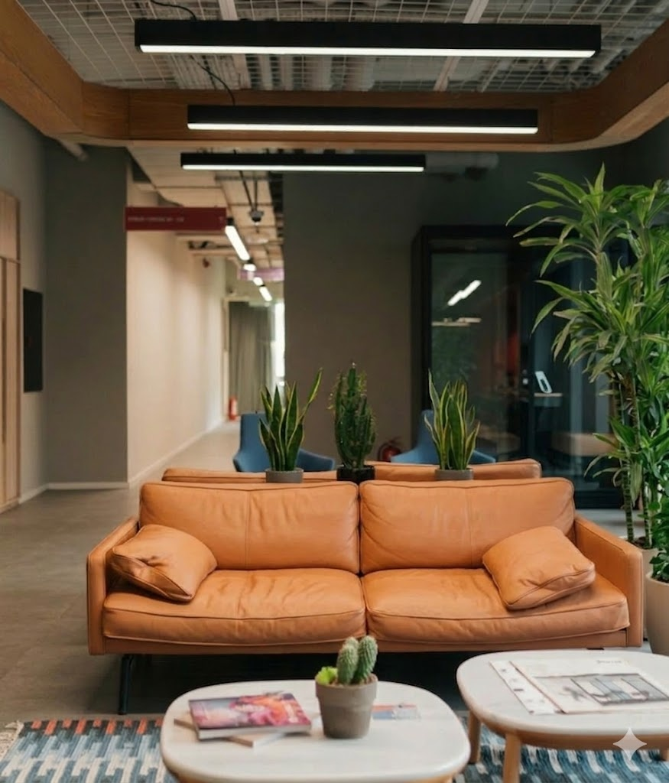
Zoe Digitals
About Us
We are a team which is an creative agency specializing in social media strategy, content development, social media management and brand storytelling.
We blend strategy, design, and engagement to help businesses grow their presence and purpose online.
2

Slide 3
Zoe Digitals
Our Approach
1
2
3
4
Discover & Align
Plan & Strategize
Create & Manage
Analyze & Refine
We begin by understanding your brand’s voice, values, goals, and audience.
We design a custom content and engagement strategy based on your objectives.
We craft visually compelling, on-brand content that resonates with your audience.
We continuously assess what’s working and what needs adjustment.
4

Slide 4




Zoe Digitals
Why
Social Media?
Builds relationships
Increases visibility
Encourages conversation
Supports long-term growth
5

Slide 5
Zoe Digitals
Goals We Help Achieve
At Zoe Digitals our social media strategies are designed to support meaningful business outcomes that go beyond likes and shares:
1
Grow brand awareness
4
Maintain consistent presence
We help your brand become more visible, recognizable, and memorable to your ideal audience.
Our content planning ensures you show up regularly and reliably across your digital platforms.
2
Strengthen audience loyalty
5
Support broader marketing objectives
By creating consistent and meaningful content, we foster deeper relationships with your community.
We align social media efforts with your larger business goals to create a unified growth strategy.
3
Drive purposeful engagement
We encourage authentic interaction that supports your brand’s message and builds trust over time.
6

Slide 6





Zoe Digitals
Core Content Themes
Behind the Scenes
Management
Inspirational
Strategizing
Promotional
7

Slide 7

Zoe Digitals
Tone & Style Guide
At Zoe Digitals, we believe that consistency in tone and style is essential to building a recognizable and trustworthy brand. We develop a clear voice that reflects your brand’s personality—whether it’s professional, friendly, bold, or calm—and carry that voice across all content.
Our visual style guide defines key elements such as color palette, typography, image treatment, and layout structure to ensure every post feels cohesive and intentional.
8

Slide 8
Zoe Digitals
Sample Content Calendar
Monday | Tuesday | Wednesday | Thursday | Friday
Tip or Insight | Visual Highlight | Team Moment | Question or Poll | Feature or Testimonial
Note:
This structure provides a consistent rhythm while allowing flexibility to adapt content based on goals, trends, or audience feedback.
9

Slide 9
Zoe Digitals
Measuring Success
Content Performance
Audience Growth & Engagement
Strategic Alignment
We track how each piece of content performs—looking at interactions, saves, shares, and reach—to understand what resonates with your audience and refine future posts accordingly.
We monitor follower growth alongside meaningful engagement, such as comments and conversations, to ensure your community is growing in both size and connection.
We assess whether social activity is supporting key business goals—like website visits, inquiries, or awareness campaigns—ensuring your efforts contribute to measurable outcomes.
10

Slide 10

Zoe Digitals
Let’s Work Together
We’re ready to bring your brand to life online.
Let’s collaborate on a strategy that fits your voice, your audience, and your goals.
Email Address
Website
Social Media Handle
info.zoedigitals.com@gmail.com
zoedigitals.in
zoemarketings

Slide 11

2025
THANK YOU FOR LISTENING
Zoe Digitals

